Slide 1
Chapter 7
Integral Calculus
The basic concepts of differential calculus were covered in the preceding chapter. This chapter will be devoted to integral calculus, which is the other broad area of calculus. The next chapter will be devoted to how both differential and integral calculus manipulations can be performed with MATLAB.

Slide 2
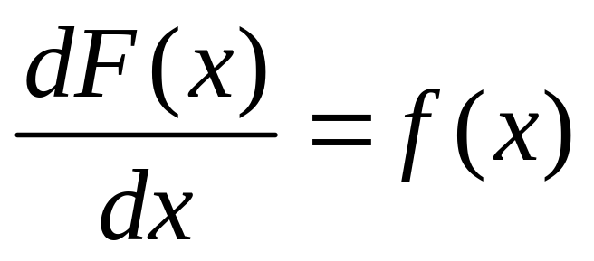
Anti-Derivatives
An anti-derivative of a function f(x) is a new function F(x) such that

Slide 3
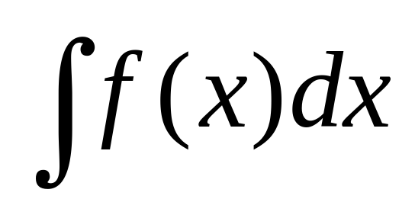
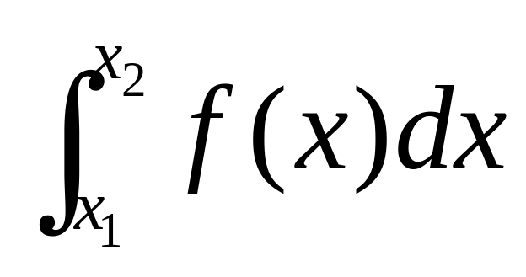
Indefinite and Definite Integrals
Indefinite
Definite

Slide 4
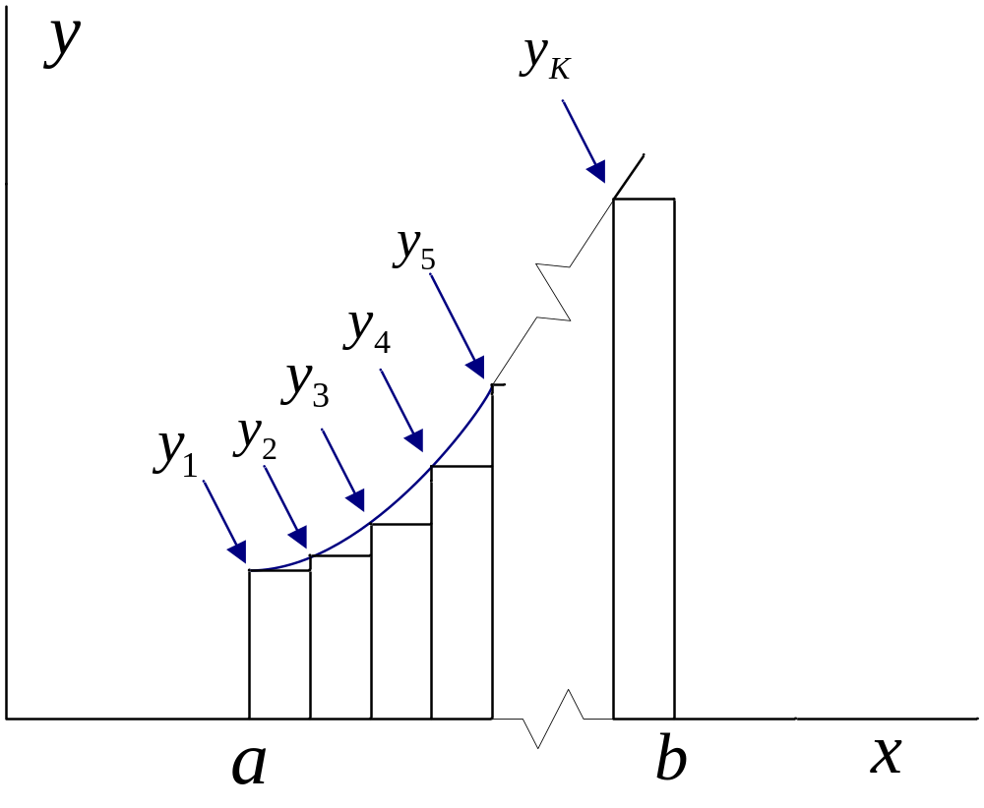
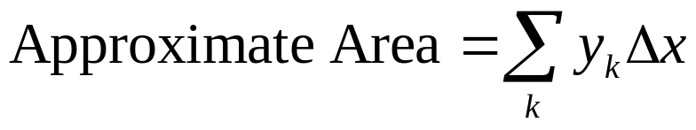
Definite Integral as Area Under the Curve

Slide 5
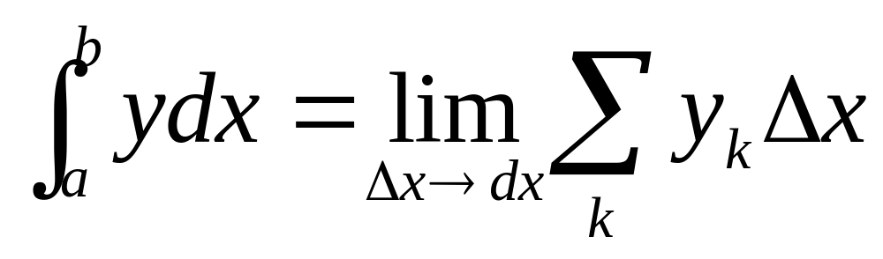
Exact Area as Definite Integral

Slide 6
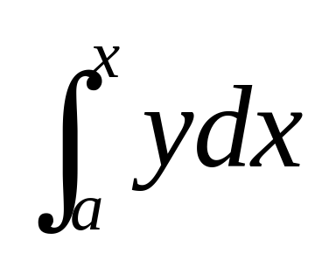
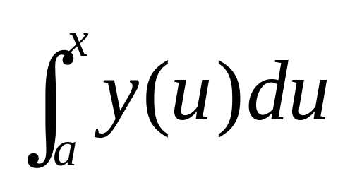
Definite Integral with Variable Upper Limit
More “proper” form with “dummy” variable

Slide 7
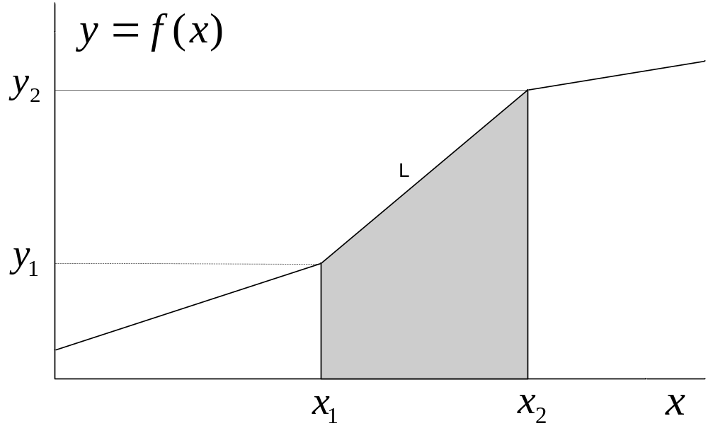
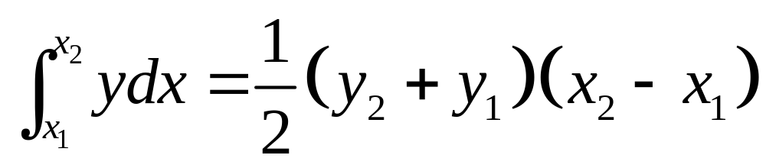
Area Under a Straight-Line Segment

Slide 8
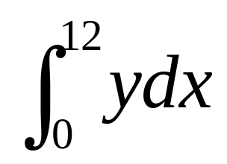
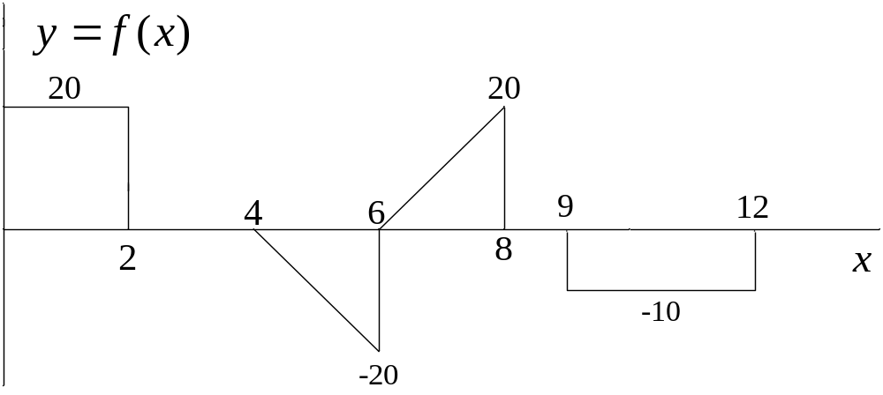
Example 7-1. Determine

Slide 9

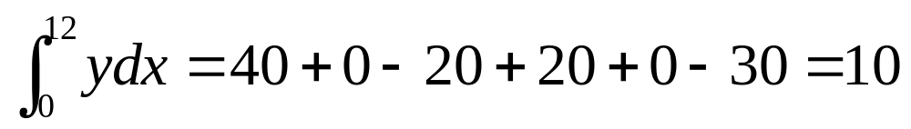
Example 7-1. Continuation.

Slide 10
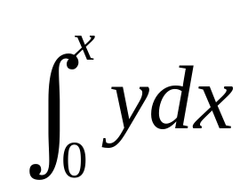
Example 7-2. Determine

Slide 11
Guidelines
1. If y is a non-zero constant, integral is either increasing or decreasing linearly.
2. If segment is triangular, integral is increasing or decreasing as a parabola.
3. If y=0, integral remains at previous level.
4. Integral moves up or down from previous level; i.e., no sudden jumps.
5. Beginning and end points are good reference levels.

Slide 12
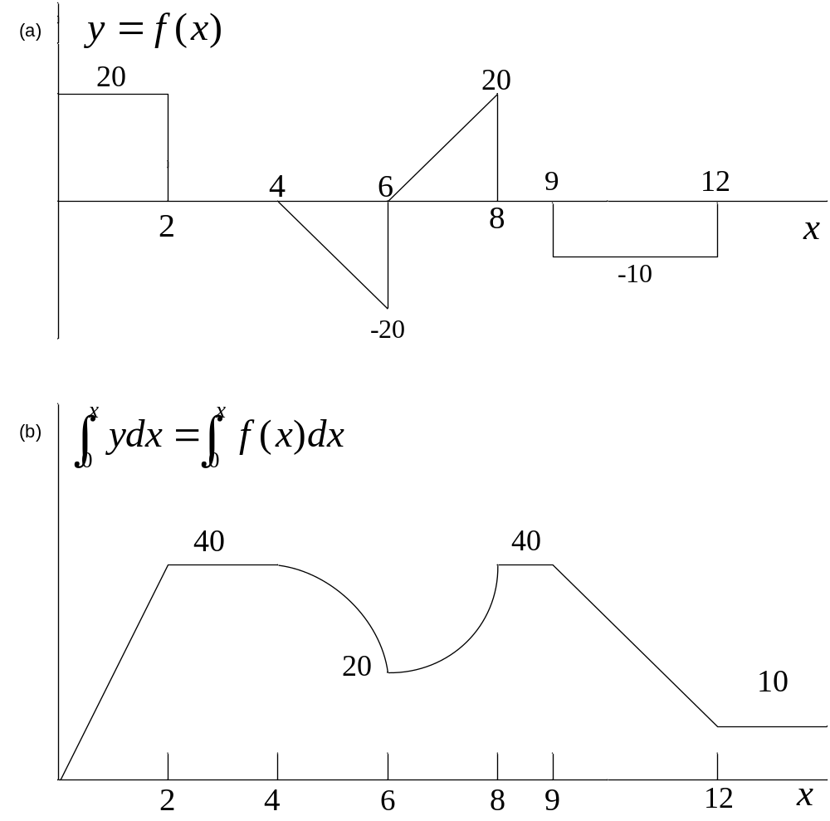

Slide 13
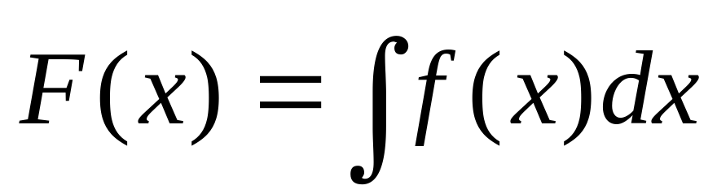
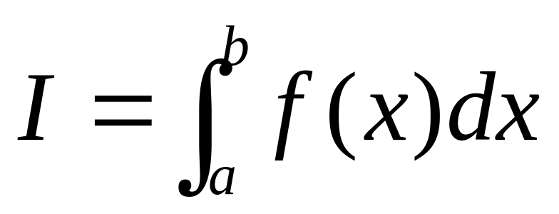
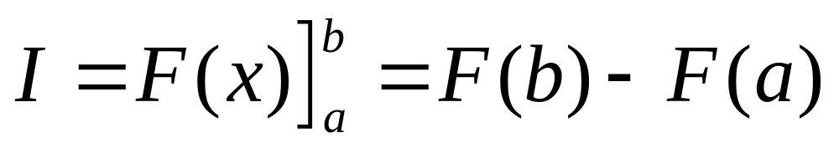
Tabulation of Integrals

Slide 14
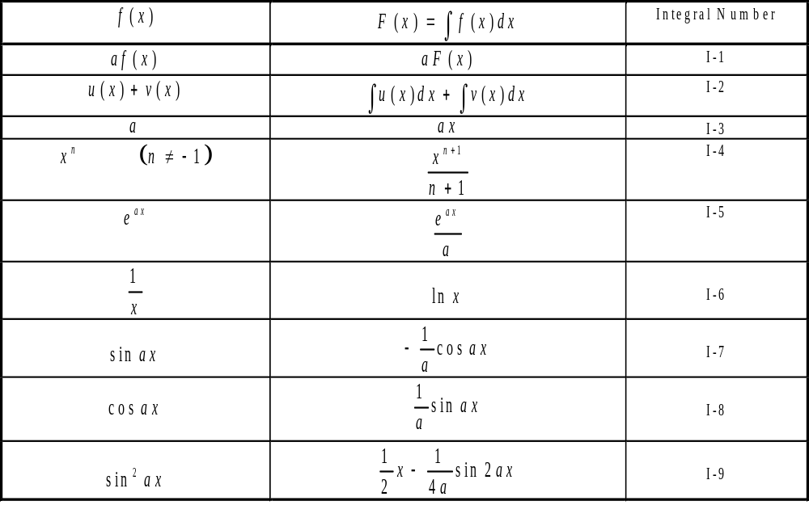
Table 7-1. Common Integrals.

Slide 15
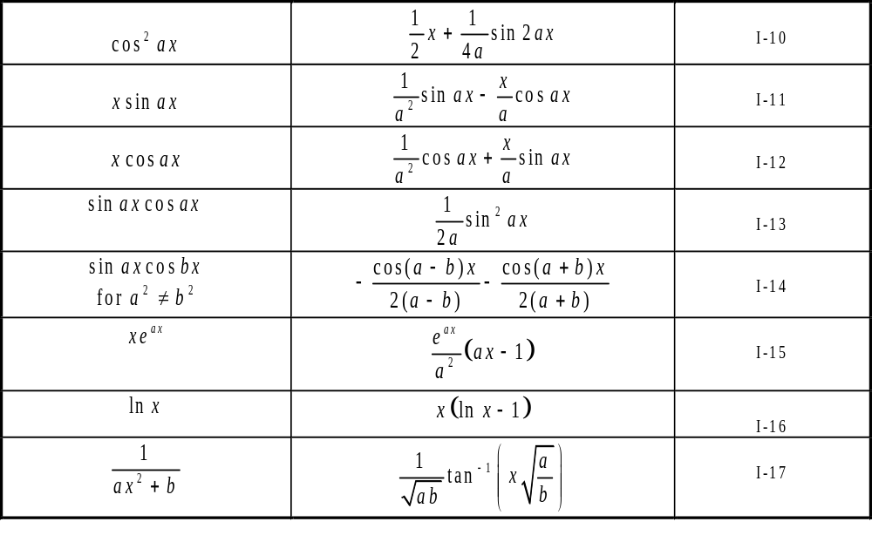
Table 7-1. Continuation.

Slide 16
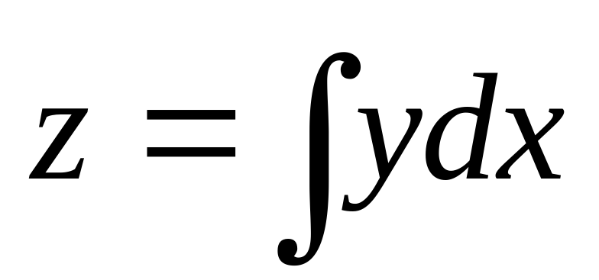
In Examples 7-3 through 7-5 that follow, determine the following integral in each case:

Slide 17
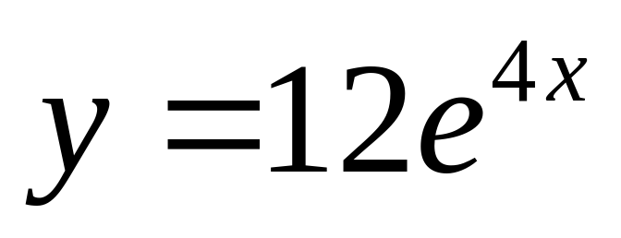
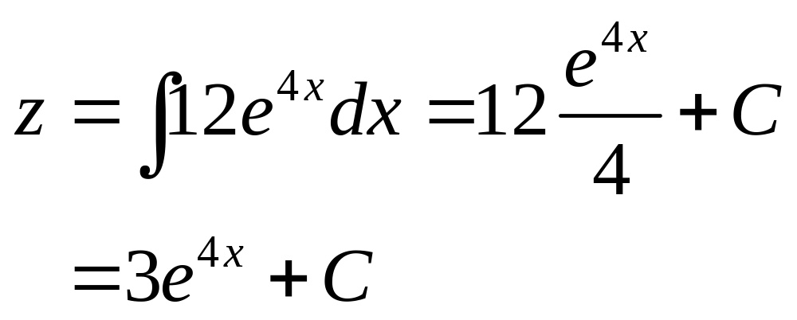
Example 7-3

Slide 18
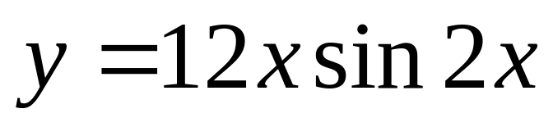
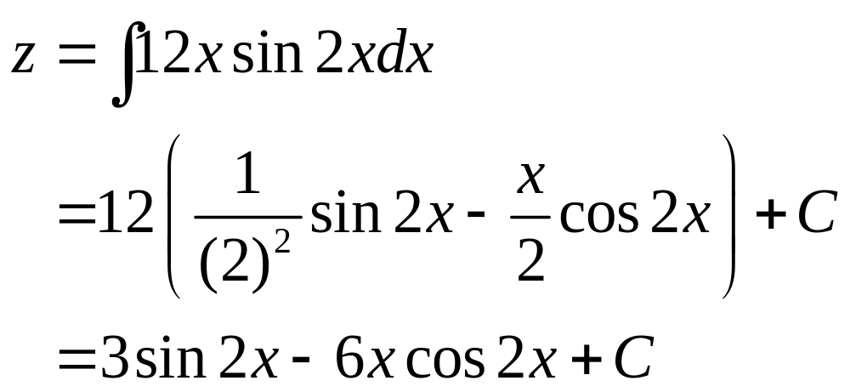
Example 7-4

Slide 19
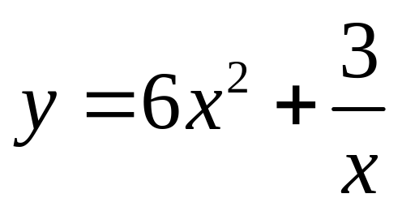
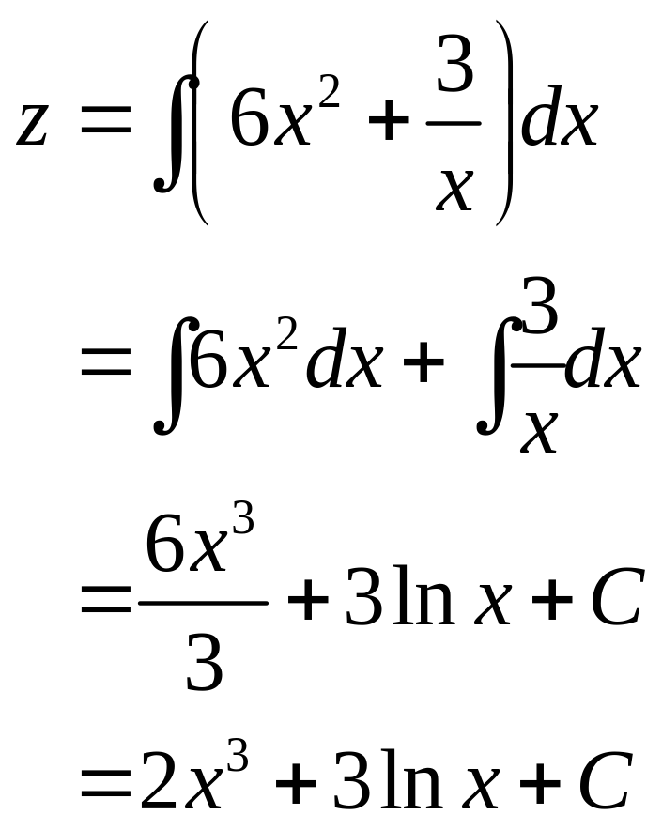
Example 7-5

Slide 20
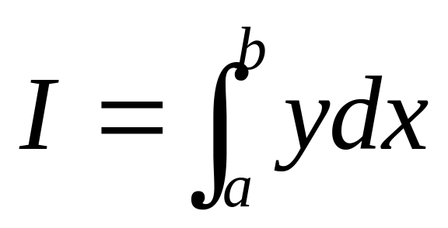
In Examples 7-6 and 7-7 that follow, determine the definite integral in each case as defined below.

Slide 21
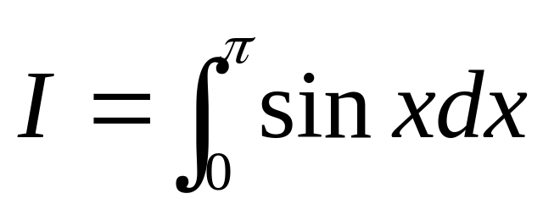
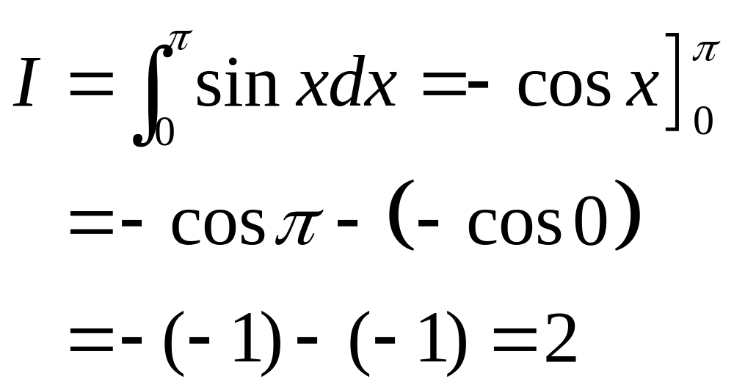
Example 7-6

Slide 22
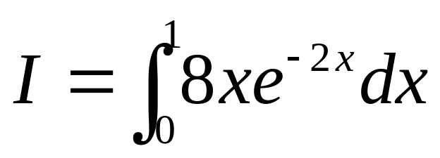
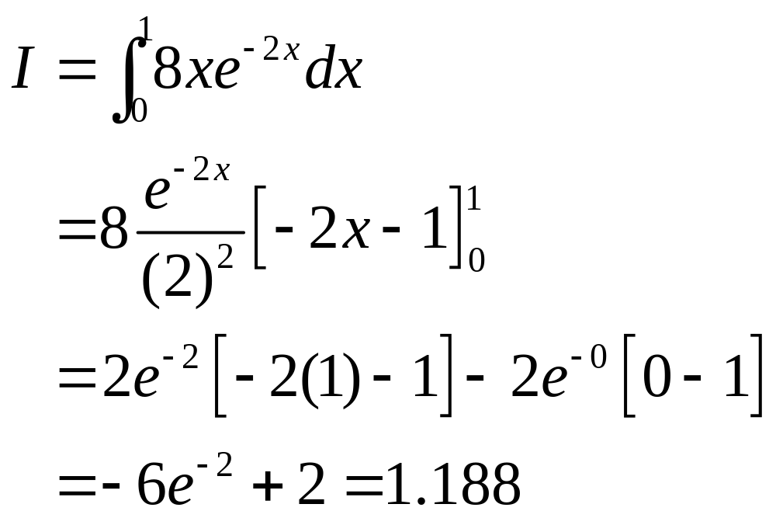
Example 7-7

Slide 23
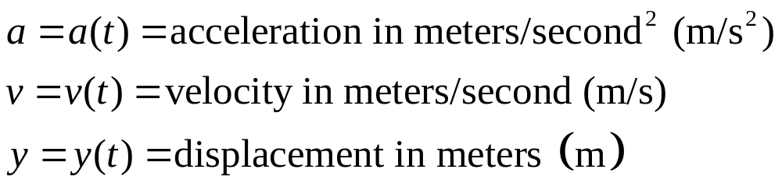
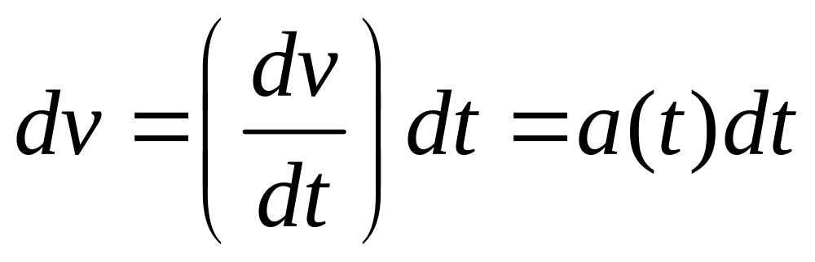
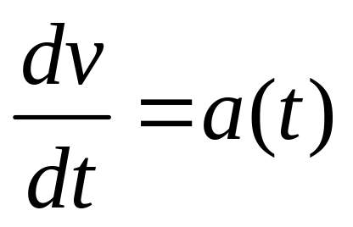
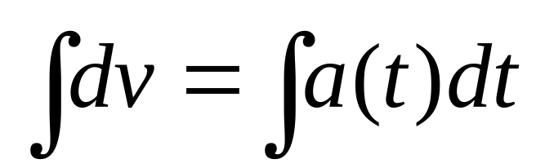
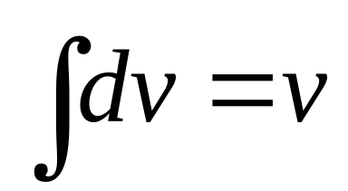
Displacement, Velocity, and Acceleration

Slide 24
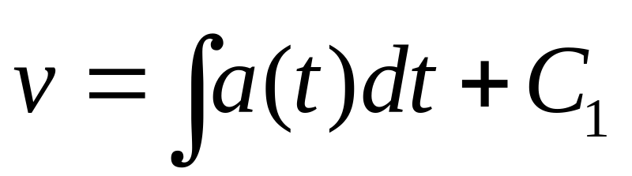
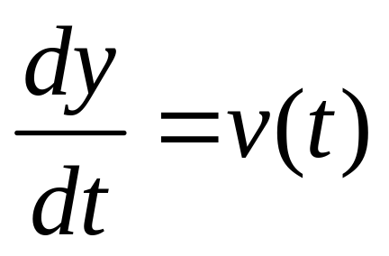
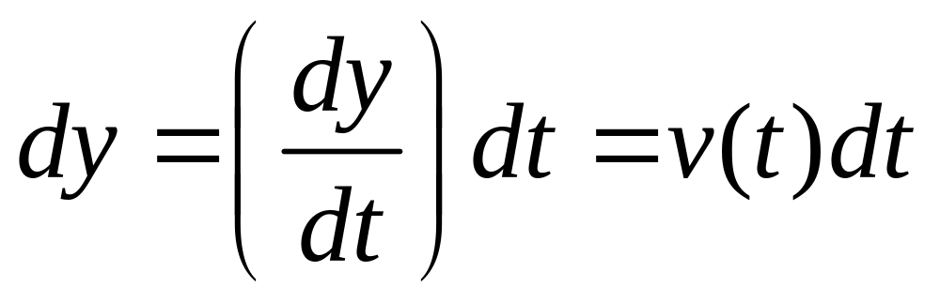
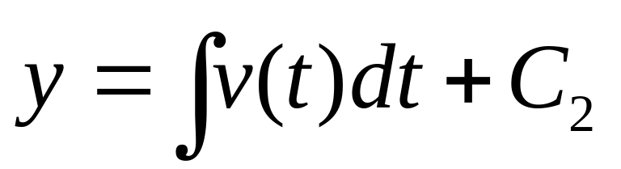
Displacement, Velocity, and Acceleration
Continuation

Slide 25
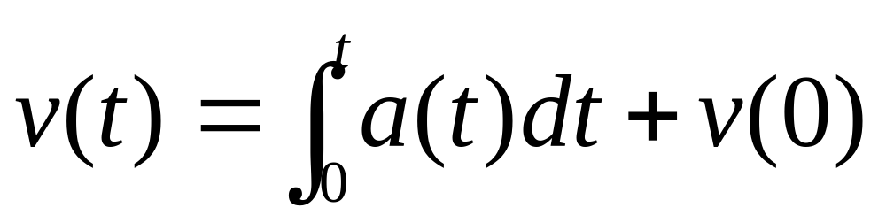
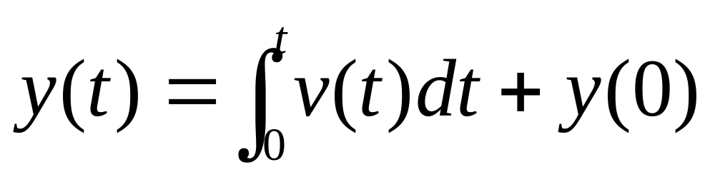
Alternate Formulation in Terms of Definite Integrals

Slide 26
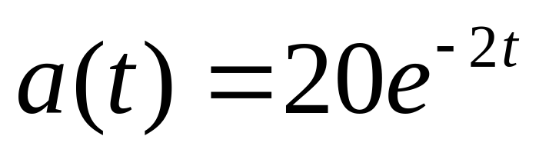
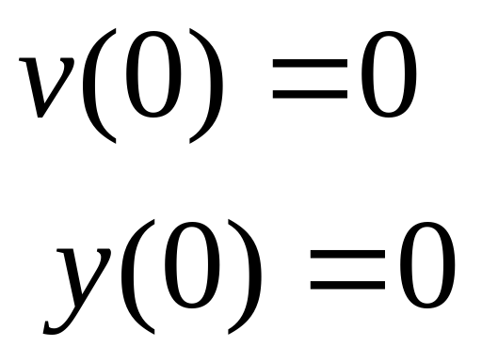
Example 7-8. An object experiences acceleration as given by
Determine the velocity and displacement.

Slide 27
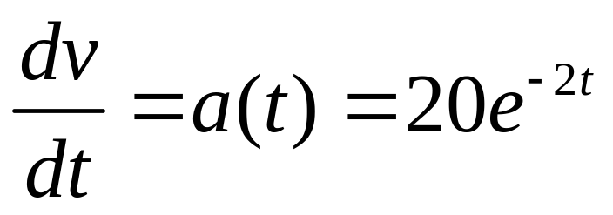
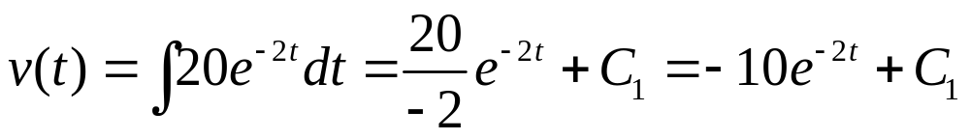
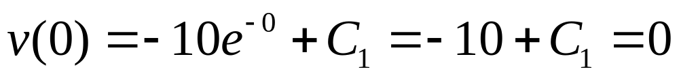
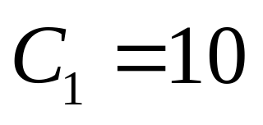
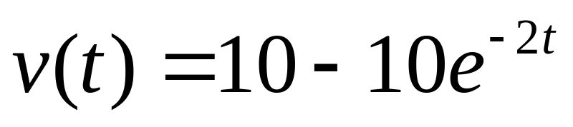
Example 7-8. Continuation.

Slide 28




Example 7-8. Continuation.

Slide 29


Example 7-9. Rework previous example using definite integral forms.

Slide 30



Example 7-10. Plot the three functions of the preceding examples.

Slide 31
Example 7-10. Continuation.
>> t = 0:0.02:2;
>> a = 20*exp(-2*t);
>> v = 10 -10*exp(-2*t);
>> y = 10*t + 5*exp(-2*t) - 5;
>> plot(t, a, t, v, t, y)
The plots are shown on the next slide.

Slide 32


